Slide 1
The Life and Works of the Real Will-Shakesy

Slide 4
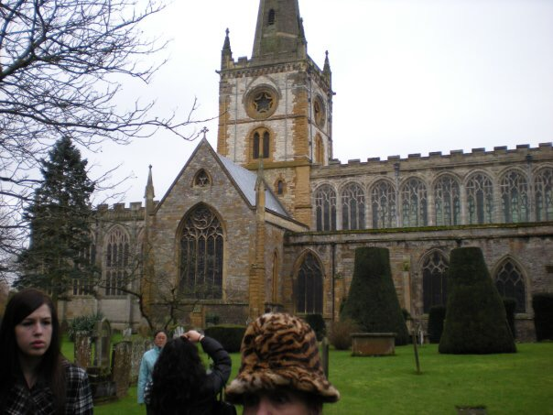

Slide 6
Birth and Early Life
Born in April1564 in Stratford-on-Avon, England (traditionally observed on April 23)
1564-1582 Does childhood stuff
1582 Marries Anne Hathaway
1585-1592 Known as “The Lost Years”
1594-1596 Writes Romeo and Juliet, Richard II, & A Midsummer Night’s Dream
1596 Shakespeares son, Hamnet dies
1599 Writes Julius Caesar
c. 1600 Writes Hamlet
1600-1616 Writes other stuff, King James coronated, a bunch of other stuff…
1616 Dies

Slide 7
Shakespeare’s Time
Queen Elizabeth I was ruling monarch, a time of national strength and wealth
English Renaissance 1500-1650
Belief that Humans had potential for development
People began to see everyday life as meaningful, and not just a preparation for eternal life
Time for heroes, ideal Elizabethan man was a talented courtier, adventurer, fencer, poet, and conversationalist. He was a witty and eloquent gentleman who examined his own nature and the causes of his actions.
Marriages were typically arranged, usually for wealth
Women had lower social status than men

Slide 8
Shakespeare’s Time
People were concerned about order of things.
When everything was in proper position, there was harmony. When the order was broken, everything was upset and everyone suffered.
People felt that their rulers were God’s agents.
Killing a King was a heinous crime; heavens would show ominous signs when such evil was present.

Slide 9
Shakespeare’s theatre
Theatre had to be marketable
Access control had to be invented and implemented to ensure only paying audience saw the play.
Enclosed space theater’s were invented as a means for controlled access
To keep audiences returning, shows had to be changed frequently
Shakespeare wrote his dramas for the stage, characters were meant to be seen and heard by audiences.
Globe Theatre – built in 1599 by Shakespeare's playing company. Perhaps most famous symbol of theater and Shakespeare in the world.

Slide 10
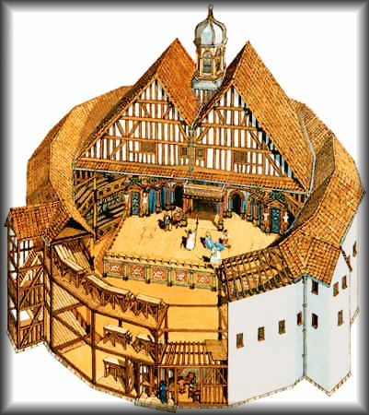
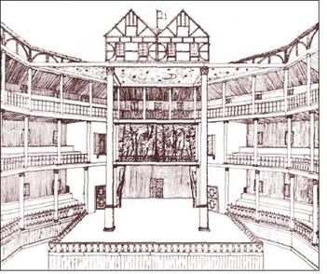
The Globe Theatre

Slide 11
The Range of Shakespeare’s Drama
Historical
Antony and Cleopatra; Julius Caesar
Comedic Relief/Comedy
Henry IV; Othello
A Midsummer Night’s Dream; Much Ado about Nothing
Tragedy
Romeo and Juliet
Hamlet

Slide 12
A note on reading Shakespeare
Keep track of characters
Read poetic language slowly
Pay attention to annotations in the text
Keep detailed notes and analyze as you read

Slide 14
Character Map

Slide 16
Dramatic Devices
Soliloquy – Monologue with the character alone on stage. This device gives the audience insight into the character’s thoughts and emotions. In Hamlet, Shakespeare uses soliloquies to allow the reader to learn the true cause of Hamlet’s state of mind and his inner desires.
Aside – When the character speaks to himself or directly to the audience. There are other characters on stage, who, by convention, do not here the aside.
Allusion – indirect reference to another event, person, or work with which the writer assumes the reader is familiar. In Hamlet, allusions are made to Greek and Roman mythology, Roman History and the Bible.

Slide 17
Dramatic Devices
Supernatural
Madness
External Conflict
Internal Conflict
Metafiction – When characters in a the play somehow call attention to the fact that they are indeed fictional characters.
Tragic Hero – According to Aristotle, was a man who rose to a high position and then fell from that high position to typically desolation and death.
Tragic Flaw vs. Fate – Two powerful forces in classical tragedy. “Waste of human potential” seems to be much more tragic to the Elizabethans than that of fate.

Slide 18
Critical Concepts with Hamlet
Hamlet as a work of renaissance Literature (Historical Critical Theory)
Hamlet’s appeal to modern readers and critics (Reader Response Criticism)
Hamlet as a model tragedy (Formalism)
Hamlet’s Psychosis (Psychological Critical Theory)
Shakespearean Grammar (Formalism)
Feminism
Mythological
Sociological/cultural

