Slide 1
Breaking down the ap essay prompt
What is the prompt asking?
How do you read/annotate for purpose?

Slide 2
What are the literary devices that you’re being asked to explore?
FOCUS - READING & ANALYSIS

Slide 3
What are the literary devices that you’re being asked to explore?
Point of View
Details
Syntax
FOCUS - READING & ANALYSIS

Slide 4
What do these mean, and how can you examine/annotate these while you read?
Point of View – the perspective from which the text is told.
Details – Imagery, internal/external dialogue, setting, description, etc.
Syntax – Punctuation, flow, paragraphs/sentences, etc.
FOCUS - READING & ANALYSIS

Slide 5
What are you using those devices to actually end up focusing your writing about?
FOCUS – ANALYSIS & WRITING

Slide 6
What are you using those devices to actually end up focusing your writing about?
“Characterizing the relationship between the young man and his father”
FOCUS – ANALYSIS & WRITING

Slide 7
Once you read and annotate, what should you focus on when planning your essay?
FOCUS – ANALYSIS & WRITING

Slide 8
Once you read and annotate, what should you focus on when planning your essay?
The relationship between father & son.
FOCUS – ANALYSIS & WRITING

Slide 9
Once you read and annotate, what should you focus on when planning your essay?
The relationship between father & son.
What details should you use to support?
FOCUS – ANALYSIS & WRITING

Slide 10
Once you read and annotate, what should you focus on when planning your essay?
The relationship between father & son.
What details from your reading should you use to support your thesis/essay?
POV, Details, Syntax
FOCUS – ANALYSIS & WRITING

Slide 11
What questions do you have?

Slide 12
Breaking down the ap essay prompt
Practice

Slide 13
READING & ANALYSIS:
What should you annotate?
ANALYSIS & WRITING:
What connections should you make and ultimately write about?

Slide 14
READING & ANALYSIS:
What should you annotate?
Literary/poetic devices
Explanations for children from adults
ANALYSIS & WRITING:
What connections should you make and ultimately write about?
How the poets explore the adult/child relationship & navigate children’s questions.
How the poets use literary devices to do this.

Slide 15
READING & ANALYSIS:
What should you annotate?
ANALYSIS & WRITING:
What connections should you make and ultimately write about?

Slide 16
READING & ANALYSIS:
What should you annotate?
Q3 – GO TO VEGAS!
No Text to annotate.
ANALYSIS & WRITING:
What connections should you make and ultimately write about?
How a character interacts/reflects/experiences past events.
How those past events have affected or shaped the character throughout the text.
How the character’s experiences have contributed to the meaning of the work.

Slide 17
What does it mean, the meaning of the work as a whole?
Consider: What is the purpose of the piece?
Example: Offred’s past…lived a normal life, husband, child, freedom, etc. Stuff happens…Offred is forced to be a handmaid…
Offred’s past life, affects her actions in the present. She has hope that her family will be reunited once again. Her relationship with the past causes her to have a will of survival. Offred’s relationship with the past, helps to create and support the theme of Rebellion throughout the novel.
Social commentary of what can happen when only a few are given the option of holding all the power, or speculative fiction/dystopian view of how a world we know can shift to this dictatorship society.

Slide 22
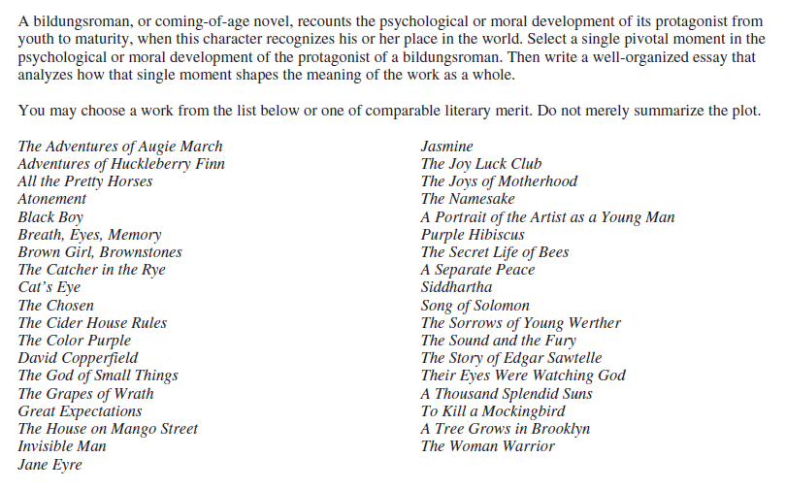

Slide 24
